Slide 1
Prediction of breast cancer outcome: clinical and mRNA gene expression array data
Vladimir Bykov

Slide 2
Datasets
Datasets (METABRIC study) were taken from cBioportal repository where authors deposit their data prior or at the time of publication.
I. Clinical and histological data: 2509 patients × 20 features
II. Gene array expression data: 1906 patients x 18544 features
Pereira B et al. The somatic mutation profiles of 2,433 breast cancers refines their genomic and transcriptomic landscapes. Nat Commun. 2016 May 10;7:11479.
Rueda OM et al., Dynamics of breast-cancer relapse reveal late-recurring ER-positive genomic subgroups. Nature. 2019 Mar;567(7748):399-404.

Slide 3
Clinical data: supervised machine learning: features
POSITIVE LYMPH NODES: a number of positive lymph nodes, indication of tumour spread
NPI: scoring of positivity of lymph nodes
CELLULARITY: amount of tumor cells in the biopsy
ER: estrogen receptor expression
HER2: Herceptin, human epidermal growth factor receptor 2, measure of tumour growth
MENOPAUSAL_STATE
INTCLUST: Integrative Clustering, 10 classes based on molecular profiling
AGE_AT_DIAGNOSIS
OS_MONTHS survival
CLAUDIN_SUBTYPE: claudin type, asessment of how tumour cells are bound to each other
THREEGENE: Triple-negative breast cancer is cancer that tests negative for estrogen receptors, progesterone receptors, HER2 receptor. Less options to treat such patient.
HISTOLOGICAL_SUBTYPE: tumour tissue structure
DOD: target variable: dead (1) or survivor (0)

Slide 4
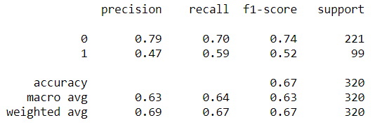

Building classification model: score on recall
It is more important not to miss patients with negative prognosis then to identify those who will do well
Selecting model:
DecisionTreeClassifier: 0.593
RandomForestClassifier: 0.526
KneighborsClassifier: 0.4
SVC: 0.436
LogisticRegression: 0.536
GaussianNB: 0.695
GaussianNB: testing model
TP FP
FN TN
The developed model beats the baseline of 30% on target class

Slide 5
Gene expression array: unsupervised machine learning
mRNA gene expression array was merged with part of clinical dataset on patients IDs with the following features:
NPI
CELLULARITY
ER
HER2_SNP6
CLAUDIN_SUBTYPE
THREEGENE
HISTOLOGICAL_SUBTYPE
DOD

Slide 6
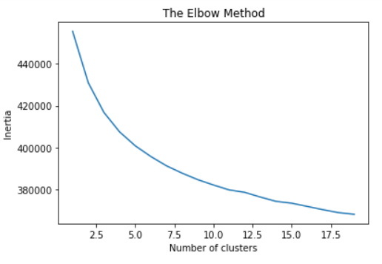
K-means clustering

Slide 7
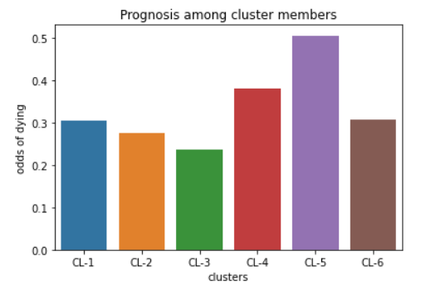
K-means clustering: 6 clusters, using prognostic variable as scoring
Cluster 5 was designated as ”worst prognosis”
Cluster 3 was designated as ”best prognosis”

Slide 8
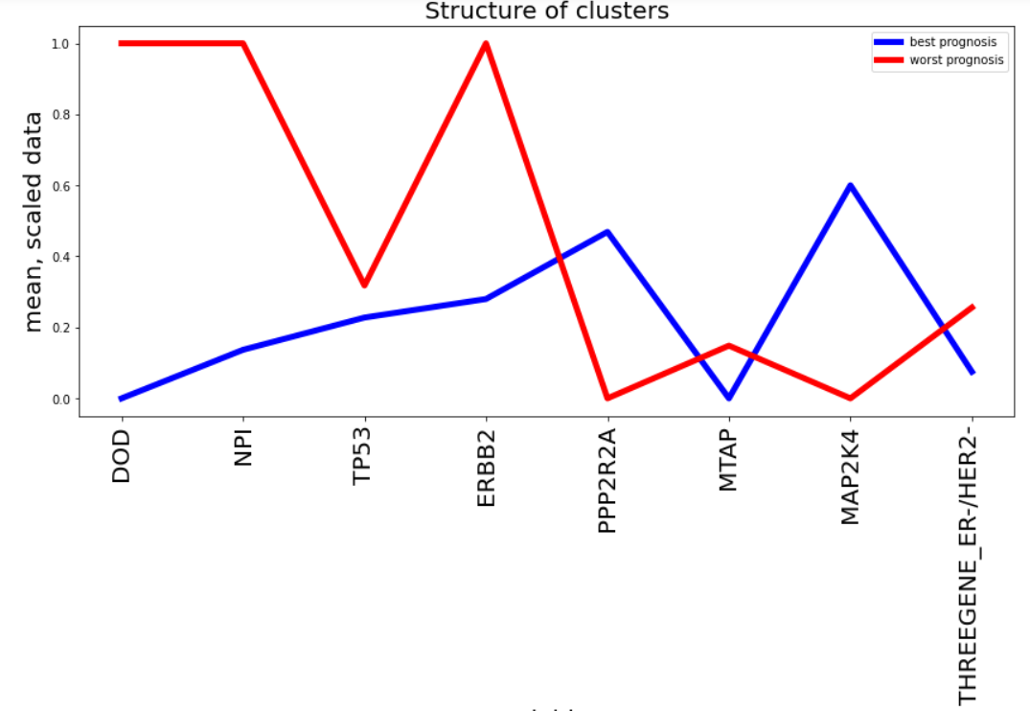
Cluster structure: worst vs best prognosis
*
*
*
* statistically significant difference (Mann-Whitney test)

Slide 9
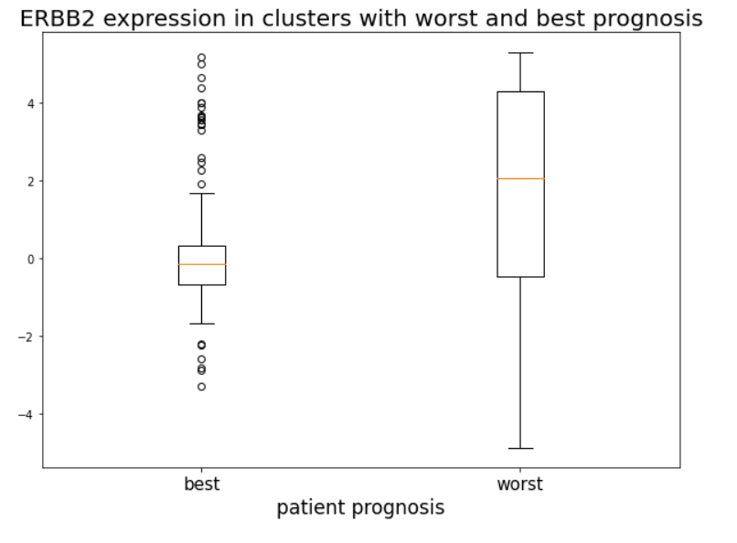
Testing hypothesis of Her2(ERBB2) gene significance on unscaled data
ShapiroResult(statistic=0.8427550196647644, pvalue=4.86e-17)
MannwhitneyuResult(statistic=24474.5, pvalue=4.34e-16)

Slide 10
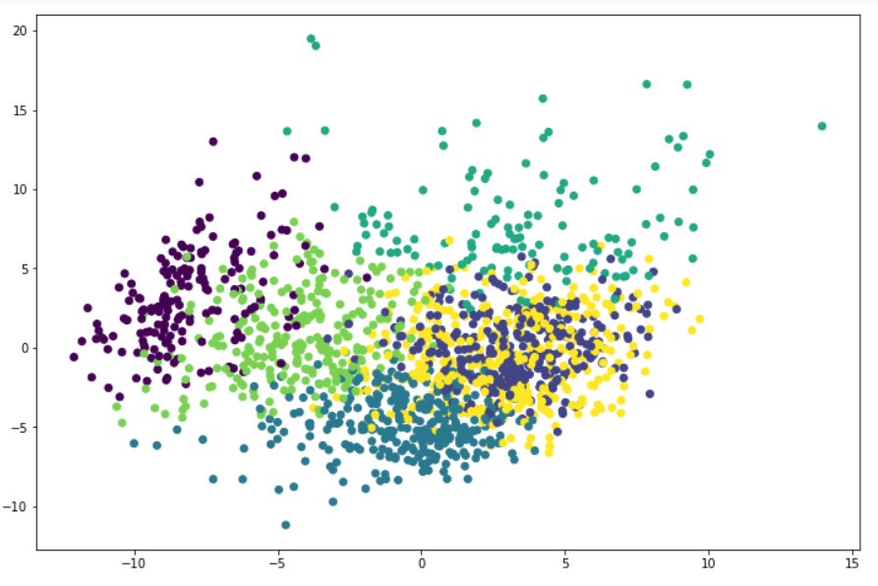
PCA: 6 clusters

Slide 11
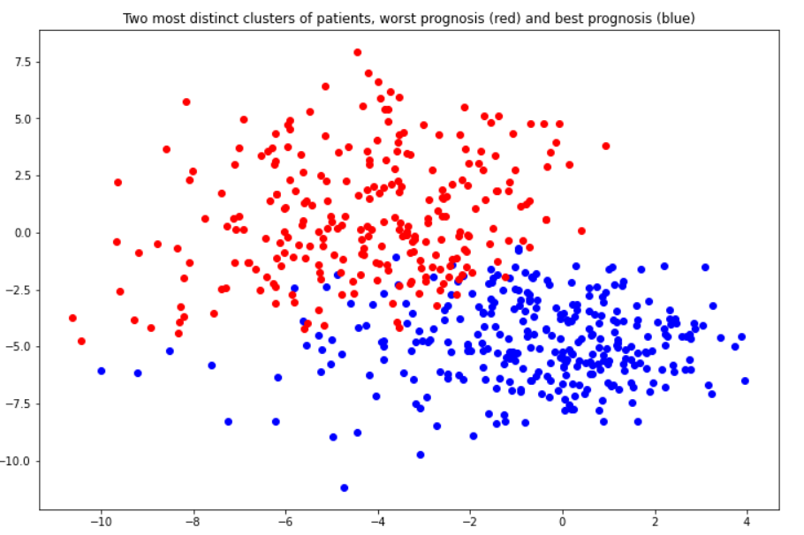
Two most prognostically distinct clusters

Slide 12
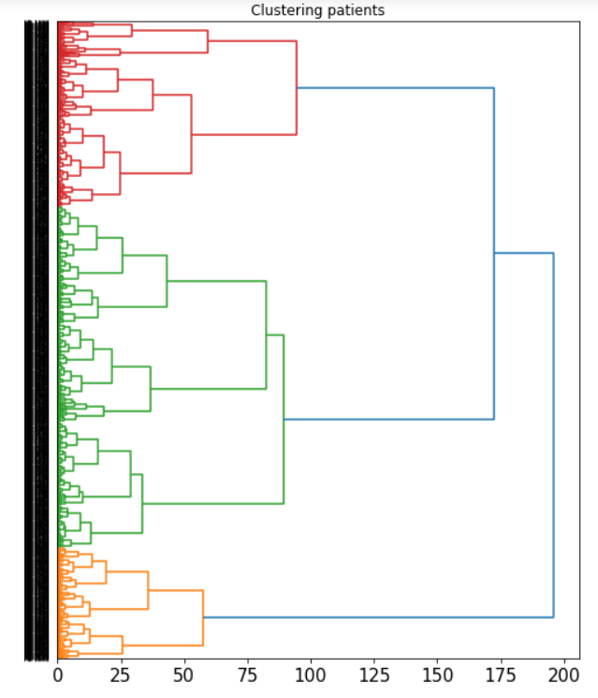
Hierarchical clustering of patients
Three major groups:
Red, Greed and Orange.
Many subclusters

Slide 13
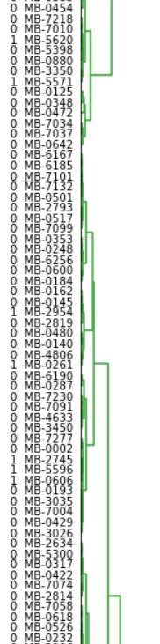
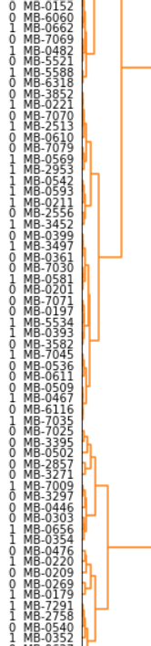
Zooming in on dendrogram: clusters have different frequency of 0 (recovery) and 1(death) from prognostic variable: target for more elaborate investigation

Slide 14
Conclusions
The supervised machine learning model was build to predict prognosis for breast patients. The model selects a group of patients who need most of medical attention and more agressive treatment.
Unsupervised clustering machine learning model suggests that mRNA expression pattern can be used as additional prognostic factor alongside with more traditional clinical and histological asessment.

Slide 15
Thank you

